Slide 1
PROJECT TITLE
Metropolitan Transportation Authority commercials pricing
Presented by: Ibrahim Alhammad

Slide 2
Agenda
01
OBJECTIVE
02
TOOLS AND DATASETS
03
SOLUTION
04
Conclusions

Slide 3
Introduction

Slide 4
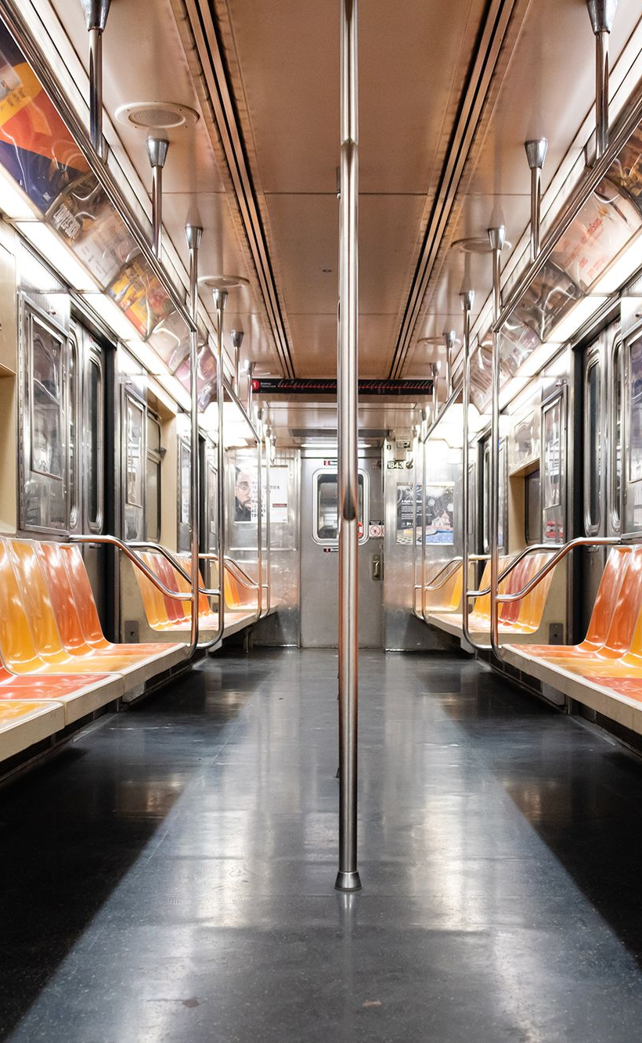
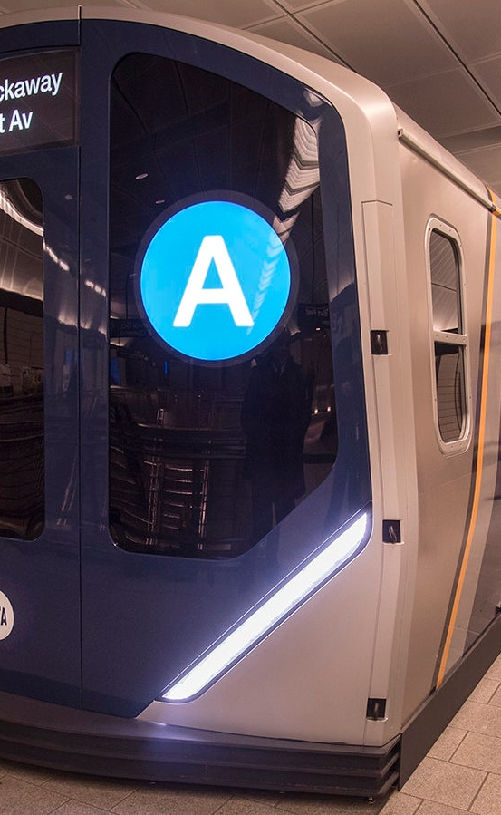
Introduction
The New York City Subway is a rapid transit system owned by the City of New York Opened on October 27, 1904
the New York City Subway is one of the world's oldest public transit systems, one of the most-used, and the one with the most stations with 472 stations operated 24/7

Slide 5
Objectives

Slide 6
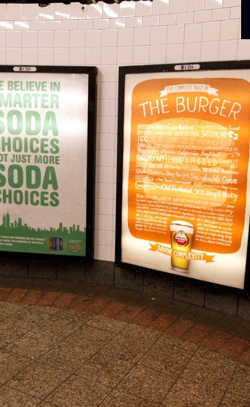
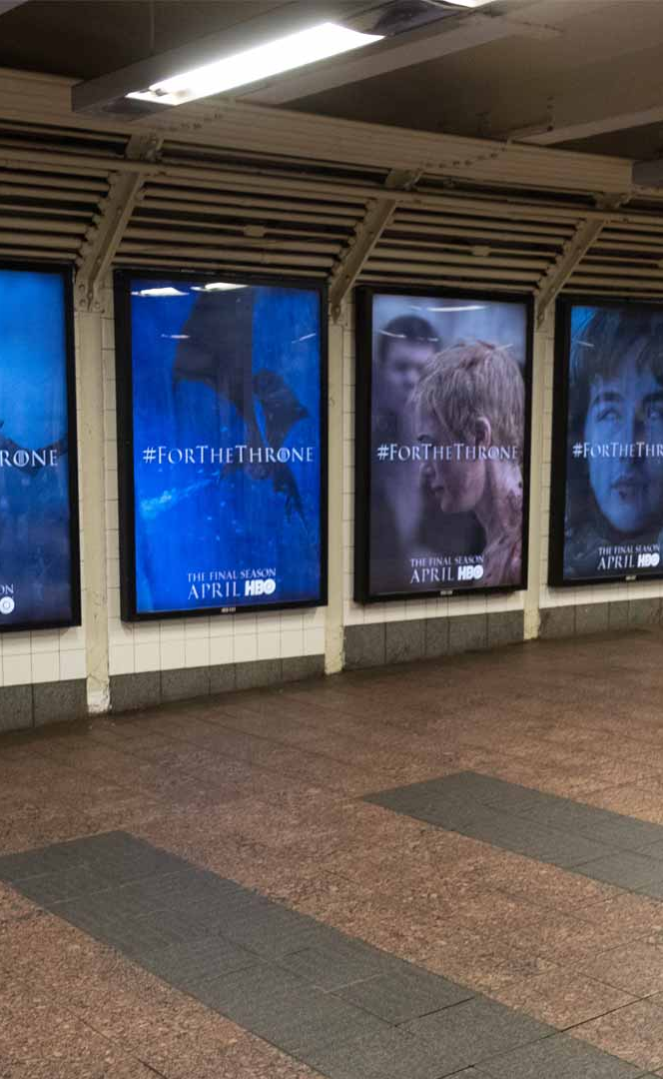
OBJECTIVES
The purpose of this expletory analysis is to help the Metropolitan Transportation Authority in New York to manage the commercials prices for the stations.

Slide 7
TOOLS AND
DATASETS

Slide 8
TOOLS AND DATASETS
The data that I will be using is coming from MTA website (http://web.mta.info/developers/turnstile.html)
For Jan, Feb and Mar of 2021
Control_Area
UNIT
Subunit
STATION
DATE_TIME
ENTRIES

Slide 9
Solutions

Slide 10
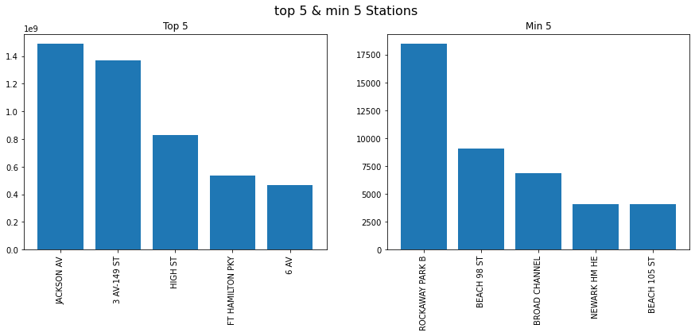
Solutions
As we can see in this figure we have the top 5 and minimum 5 entries in the first 3 months of 2021

Slide 11
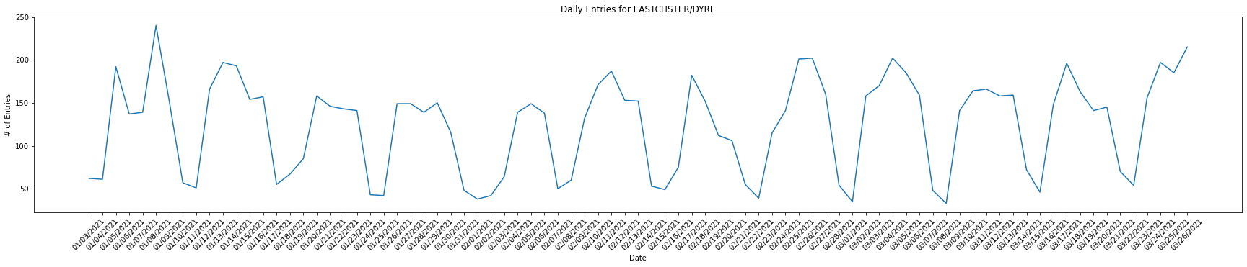
Solutions
As we can see in this figure the Daily entries of EASTCHSTER/DYRE for the 3 months we can see that the most entries are in the working days

Slide 12
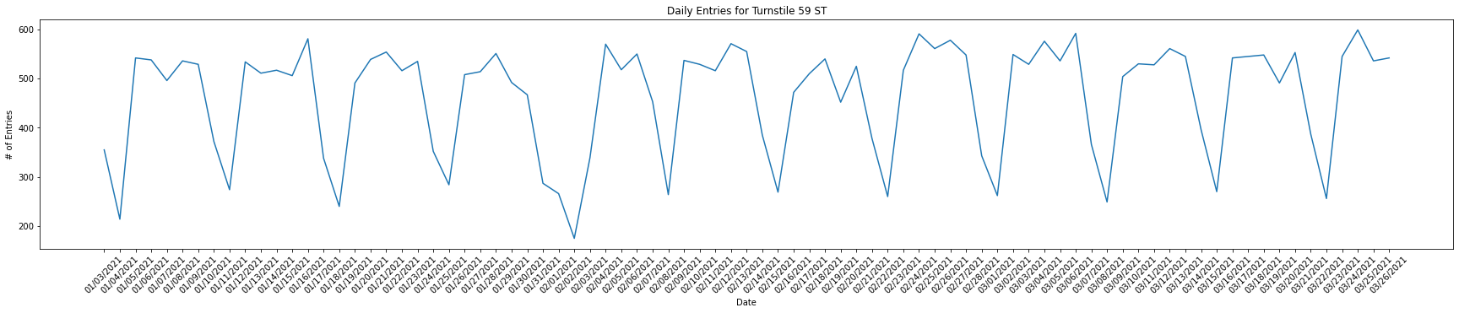
Solutions
As we can see in this figure the Daily entries of 59ST for the 3 months we can see that the most entries are in the working days

Slide 13
Conclusions

Slide 14
Conclusion
The MTA have to consider the advertising prices based on the interies of each station
The MTA can consider the prices based on work days or weekends like we see that some stations has more interies in work days than weekends

Slide 15
Thank You
And have a nice weekend

